Slide 1

Internship Presentation
SWE 4790: Internship

Slide 2
Lamia Bint Mokbul
Antara Arifa Mullick
Saadman Sakib
210042123
210042132
210042165
‹#›

Slide 3
Motivation
Bridging Theory and Practice
Bridging Theory and Practice
Learning Industry
Best Practices
Bridging Theory and Practice
Embracing Corporate Culture
Learning Industry Best Practices
Embracing Corporate Culture

Slide 4

Our Company
TiCON System Limited (TSL), founded in 2007 and headquartered in Seoul, South Korea, is a global technology company with an R&D center in Dhaka, Bangladesh.
‹#›

Slide 5
Company Milestones
Years of Experience
Global Clients
17+
20+
100+
200+
Countries Served
Projects Completed
‹#›

Slide 6
Locations
Head Office (South Korea)
R&D Center (Bangladesh)
USA Office
1306, 243 Digital‑ro, Guro‑Gu, Seoul (08382), South Korea.
Level 6, House of Veritas, 8 Gareeb‑e‑Newaz Ave, Sector 13, Uttara, Dhaka‑1230, Bangladesh.
8609 Westwood Center Dr, Suite 110, Tysons Corner, VA 22182, USA.

Slide 7

Company Environment
01
02
03
04
5 Working Days a Week
Standard work-week with 8 hours per day
Work-from-Home Flexibility
Provides options for remote work, promoting work-life balance
Flexible Leave Policy
Employees can take leave as needed with a flexible approach
Office Locations
Three collaborative offices located in South Korea, Bangladesh and USA

Slide 8
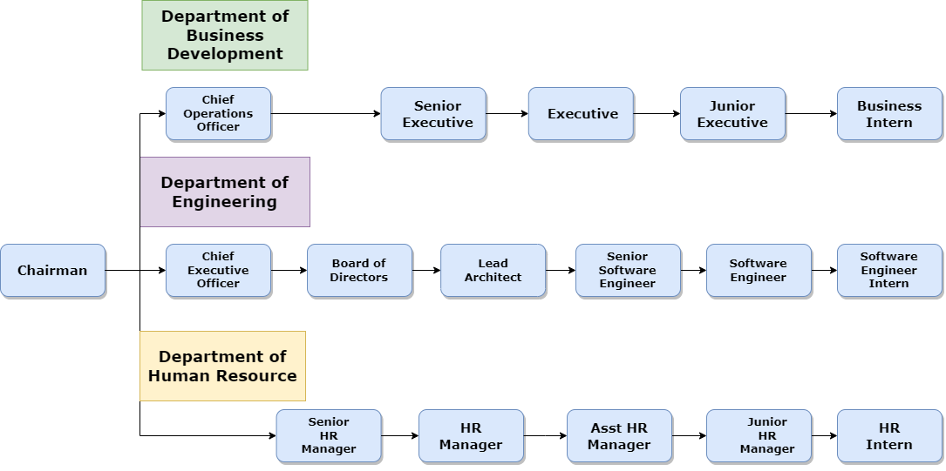
Organogram

Slide 9

Collaboration with Colleagues
Open Communication
Daily stand-up meetings and messaging tools helped maintain clear communication
Cross-Functional Teamwork
Worked closely with developers, project managers, and clients to discuss requirements, share feedback
Supportive Work Culture
Senior designers, developers provided guidance, feedback, and continuous support throughout project development.

Slide 10
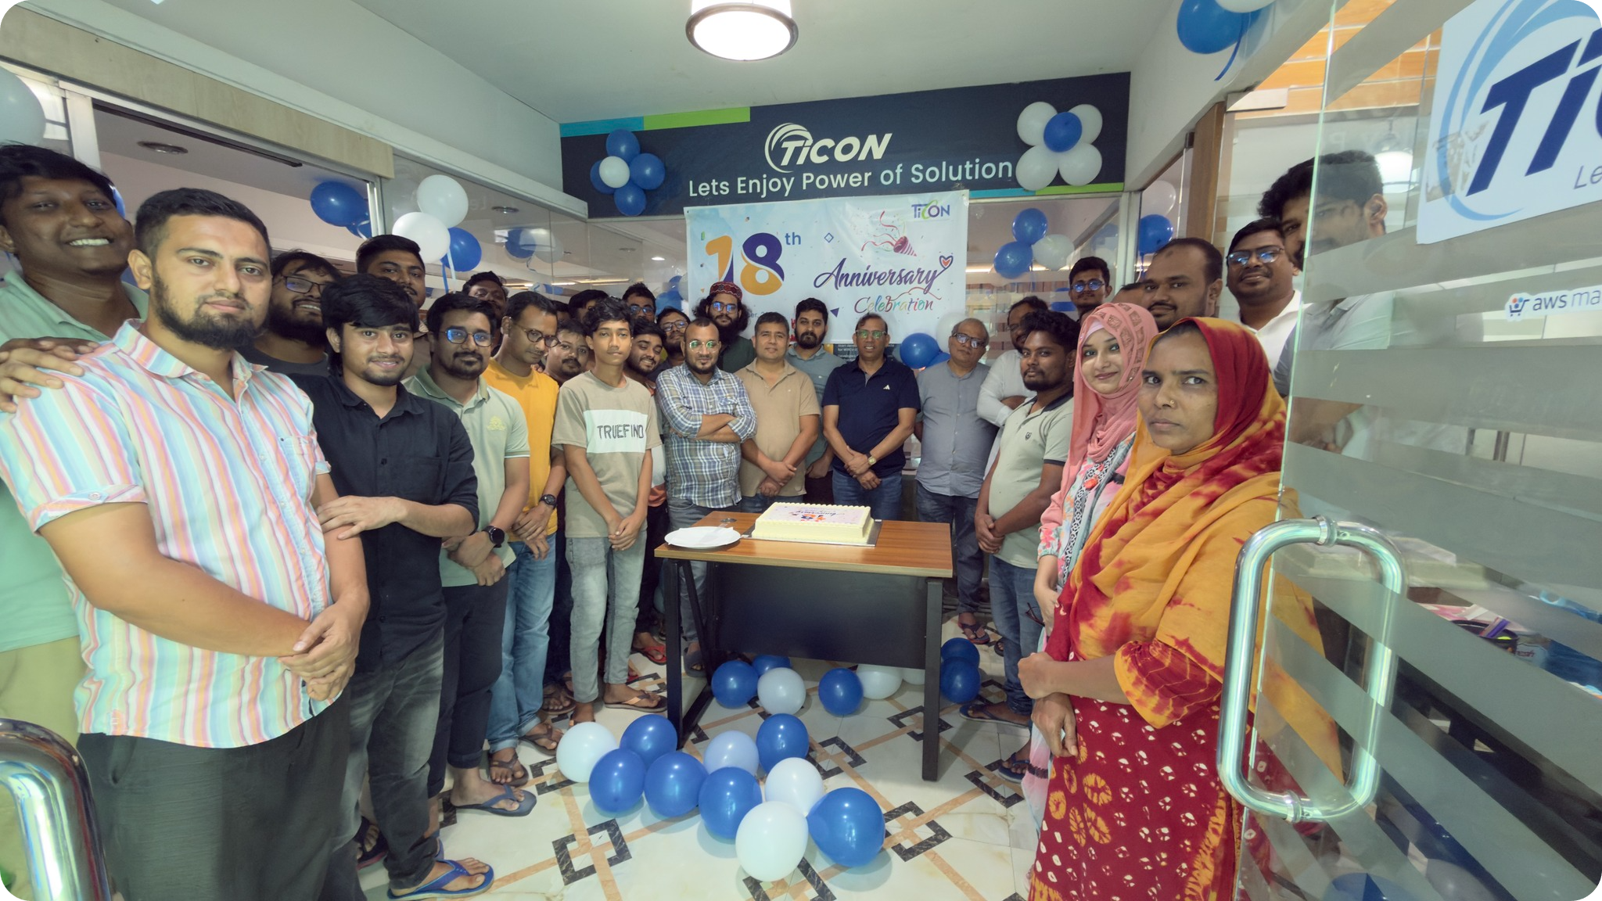
Events and Activities
Founding Anniversary Celebration
Monthly Festive Lunch
Farewell Celebrations

Slide 11
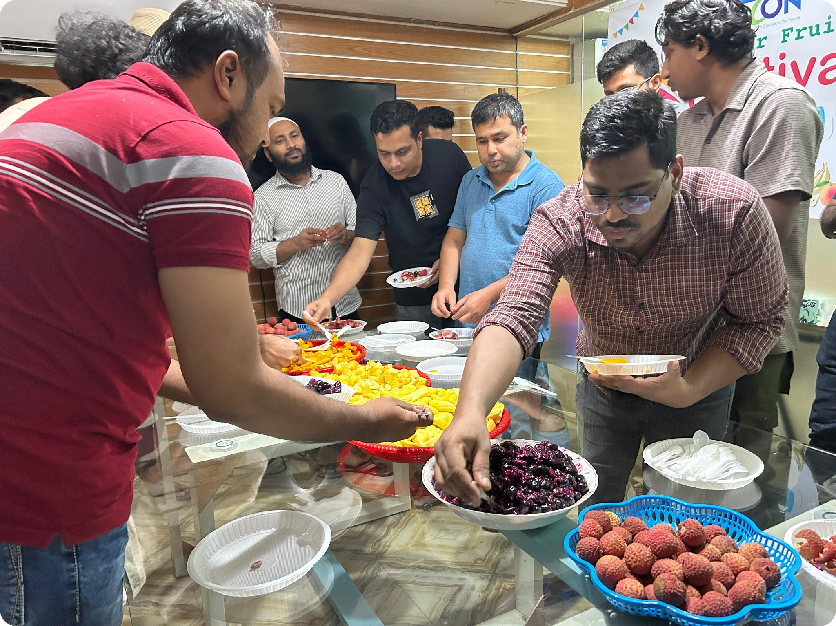
Events and Activities
Summer Fruit Festival
Eid Reunion Celebrations
Knowledge sharing Sessions

Slide 12
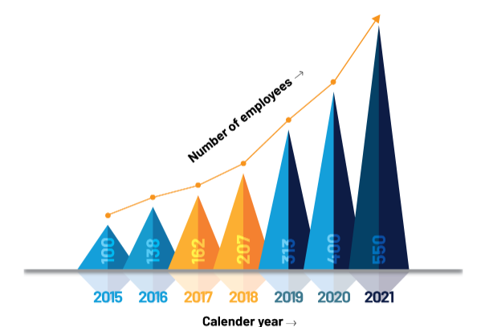
Company Workflow
01
02
03
Methodology
Primarily used Scrum Framework to manage and execute tasks within the team
Service-Oriented Company
Focused on delivering comprehensive solutions tailored to client needs
In-house Projects
Aimed at improving internal processes and enhancing the employee management

Slide 13
Antara Arifa Mullick
210042132
October 12, 2025 - February 12, 2026
‹#›

Slide 14
Team Overview
Structure
Objective
Dynamic team of senior and intern developers and designers.
Explore the sector under the careful guidance of mentor
Goal
Mission
Design and Develop efficiently fulfilling all the requirements.
Ensure a reliable environment for development and testing
‹#›

Slide 15
Initial Learning Phase
Languages
Gained knowledge on Html, Css, JavaScript, TypeScript, Next.js.
Frontend Frameworks
Developed responsive components using Next.js, React.js, and Tailwind CSS.
Emphasized modular components for reusability and maintainability.
Collaboration & QA Tools
Used Google Sheets for bug tracking and issue logging.
Communicated via Google Chat and Google Meet.

Slide 16
Projects
‹#›

Slide 17
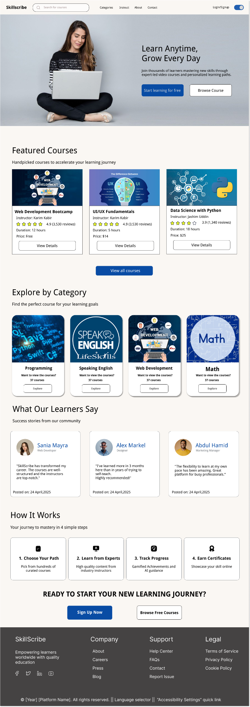
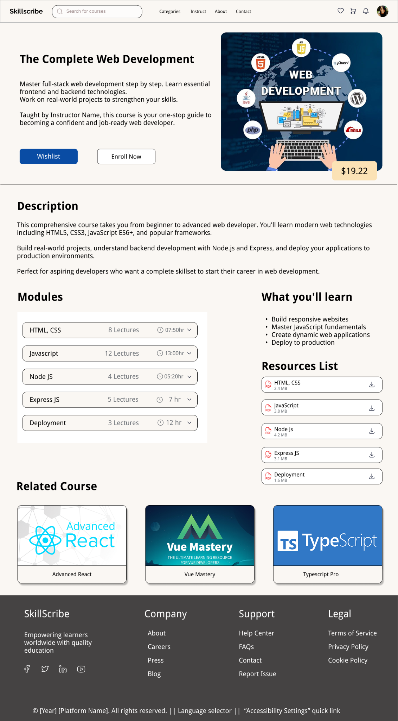
1. Skillscribe
Designed wireframes and developed key features for both student and admin roles.
Developed navigation bar, footer, learner dashboard, settings page, and AI assistance feature.
Created landing page, course player, course details, quiz sections, reviews and certificates.
Integrated advanced functionalities such as wishlist, add to cart, dummy payment process and community chat.
Developed multiple admin pages, including User Management, Instructor Verification, Course and Category Management, User Report, Financial Report, History etc..
‹#›

Slide 18
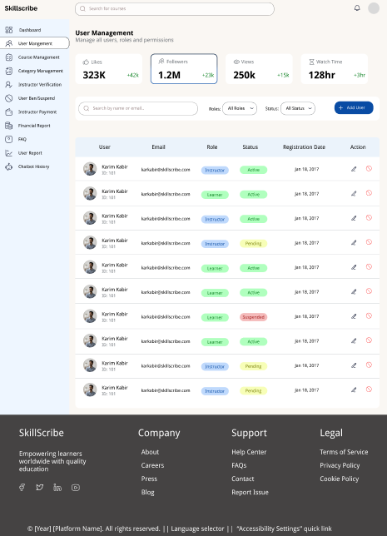
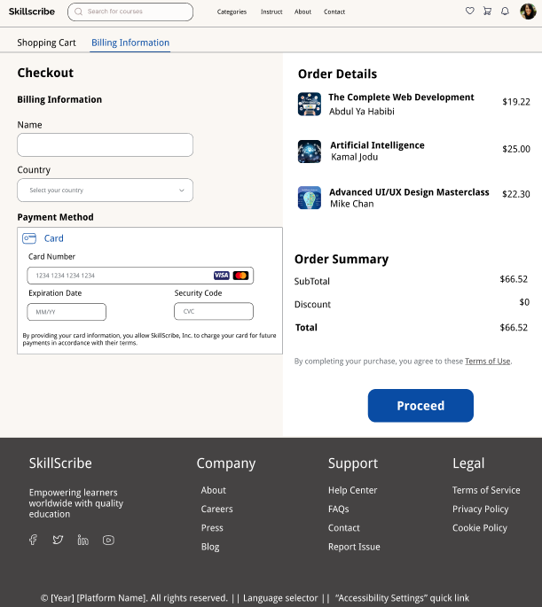
1. Skillscribe
Conducted thorough testing for both side pages, addressing and resolving all identified issues.
Outcome
Learned to design and implement end-to-end user journeys for both students and admins.
Developed skills in responsive design and complex state management
Gained experience on working with Nextjs and TypeScript
Strengthened front-end skills, focusing on performance and user experience
‹#›

Slide 19
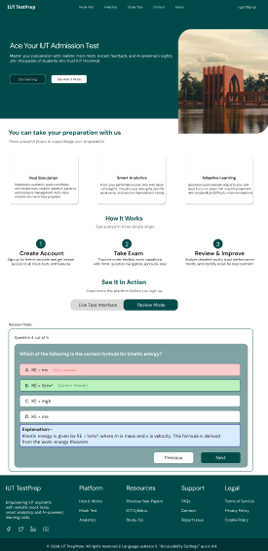
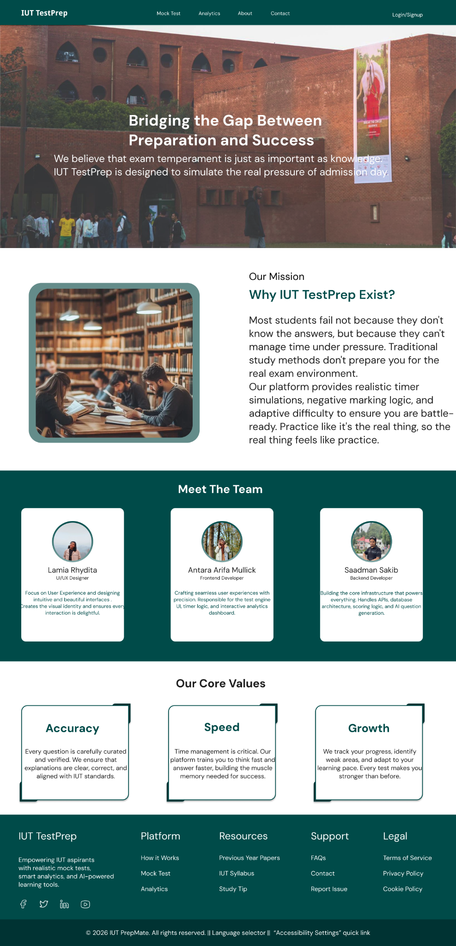
2. IUT Test Prep
Led frontend development for both student and admin roles.
Developed pages such as Landing Page, Mock Test, Exam, Result, Analytics page and integrated timer and quiz functionalities.
Developed Study Tips and FAQ pages for both the roles.
Built and integrated admin pages including Overview, Contact Messages, Users, Question Bank.
Enhanced UI of the entire project, ensuring responsiveness and visual alignment with design specifications.
‹#›

Slide 20
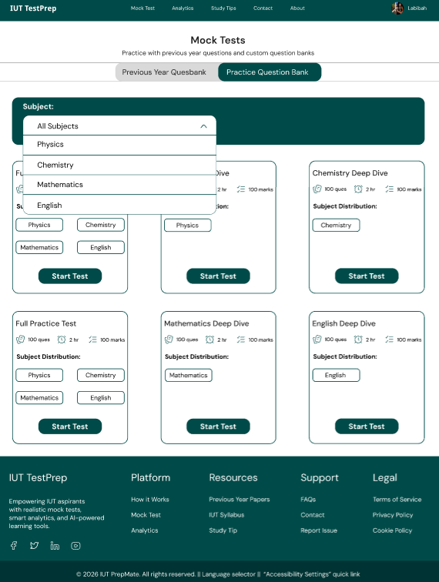
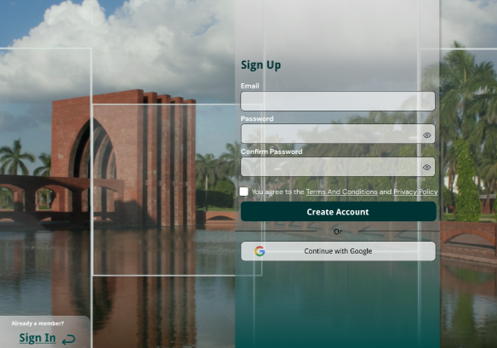
2. IUT Test Prep
Collaborated with the backend team for smooth API integration and ensured full functionality.
Outcome
Gained experience in building interactive, data-driven frontend pages for a website.
Enhanced skills in integrating frontend with backend APIs, ensuring seamless data flow and functionality.
Improved my ability to develop responsive, user-friendly interfaces, focusing on performance optimization and alignment with UI designs.
‹#›

Slide 21
3. GPDI Platform
Outcome
Conducted UI and functional testing for the GPDI AI procurement intelligence platform
Used Postman for API testing and validated the functionality across different pages
Validated design implementation against original Figma specifications.
Organized and recorded bugs, interface discrepancies, and usability problems in Google Sheets.
Gained systematic method for quality assurance and bug documentation
Gained understanding of how design and development align together
Developed skills in performing UI, Functional and API testing
‹#›

Slide 22








Tools and Frameworks
JavaScript
React
TypeScript
Next.js
Tailwind CSS
Google Chat
Github
Figma

Slide 23
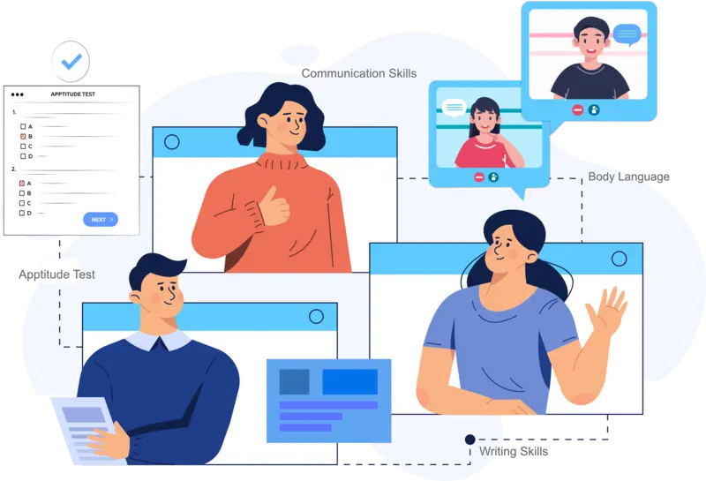
Soft Skills
01
02
03
04
Communication
Reached out promptly to teammates and supervisor for support and guidance
Adaptability
Adapted to new work environment and new people
Punctuality
Maintained deadline for tasks and managed office work hours responsibly
Workplace Discipline
Provided regular updates as to keep team informed and aligned

Slide 24

Thanks!
‹#›

Slide 25
Lamia Bint Mokbul
210042123
Duration: Oct 12, 2025 - Feb 12, 2026
‹#›

Slide 26

Overview of team
Worked under the UI/UX Design team at TiCON System Ltd.
Received tasks directly from both the team lead and Senior Designer
Used Google Chat for resource sharing, updates, and quick check-ins
Collaborated closely with developers to ensure design-to-implementation alignment

Slide 27

Initial Learning Phase
01
02
03
04
Languages
Strengthened understanding of HTML and CSS for identifying frontend issues during testing
Design Tools
Figma for wireframing and prototyping
Design Frameworks
Learned Material Design guidelines and design principles
Collaboration & QA Tools
Used Google Sheets for bug tracking, Google Chat and MS Teams for team communication, FigJam for brainstorming

Slide 28
Projects
‹#›

Slide 29
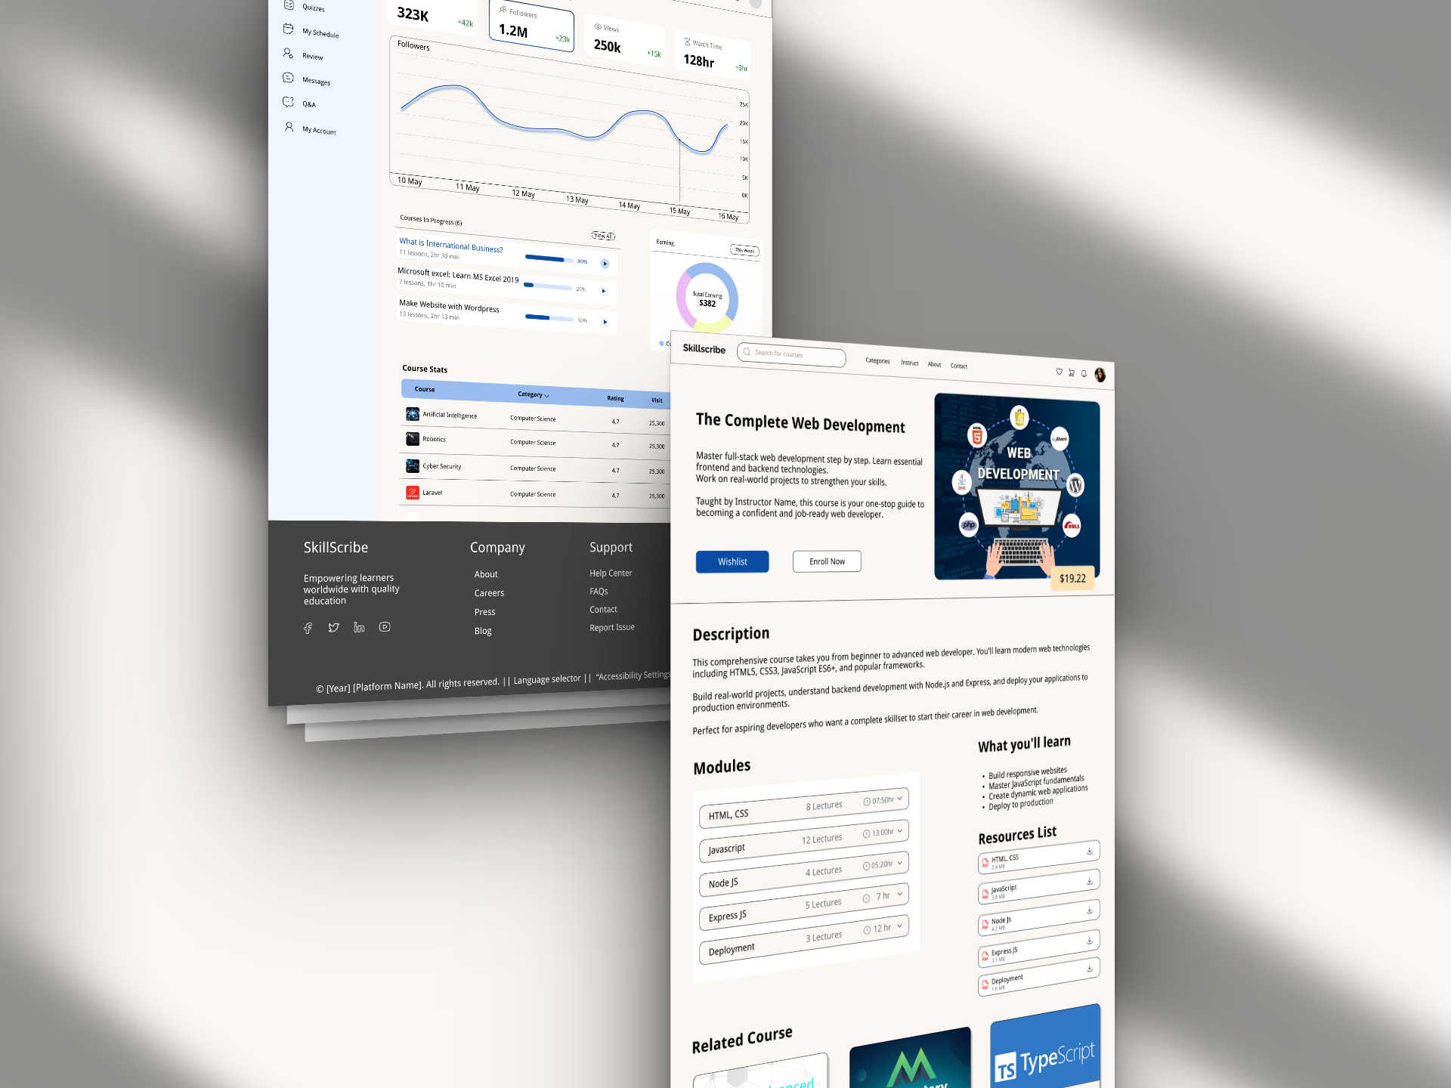
Project Involvement
Skillscribe
Outcome
Designed wireframes and high-fidelity UI for three user roles: Learner, Instructor, and Admin
Created 35–40 screens covering registration, course browsing, quiz, and certificate flows
Conducted frontend and UI testing, identifying and documenting interface issues
Learned to design end-to-end user journeys from enrollment to certification
Gained hands-on experience in role-based UX design

Slide 30
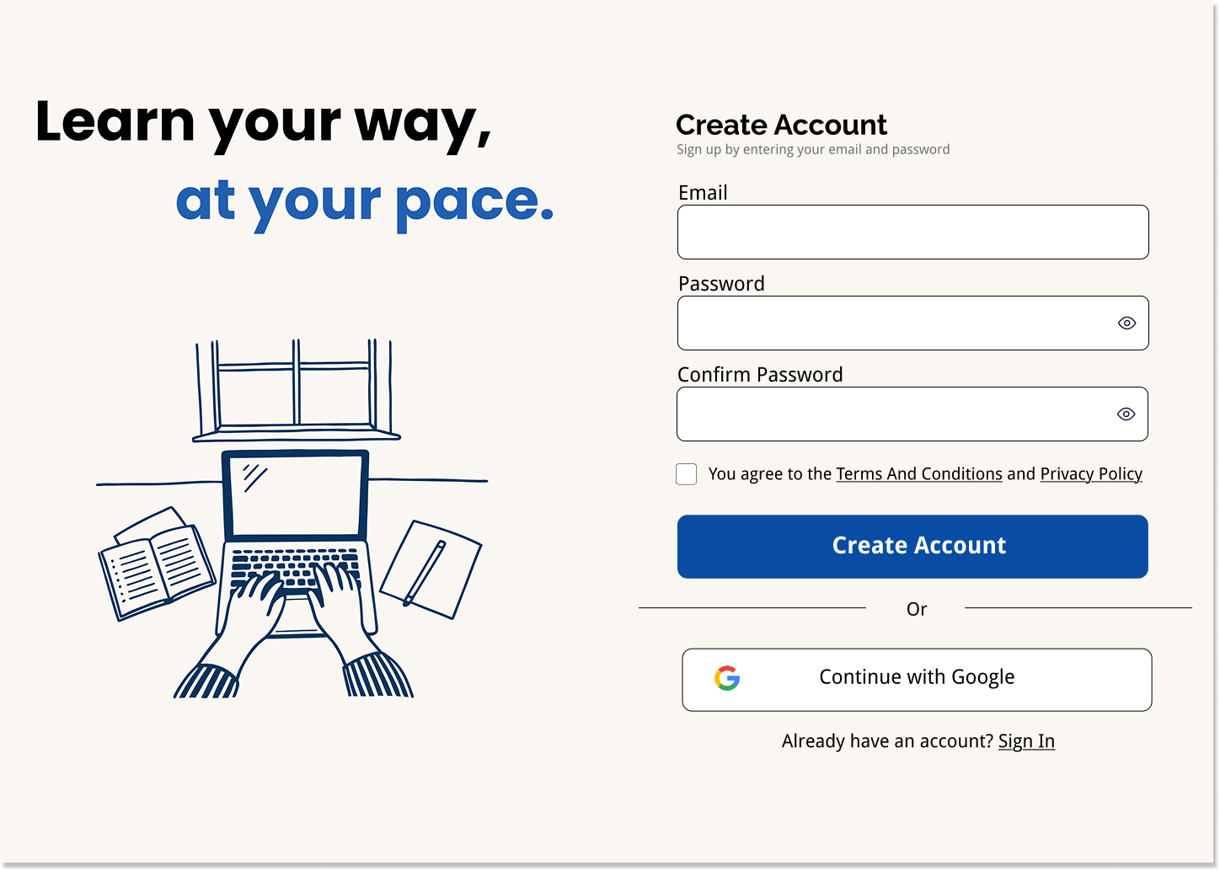
Project Involvement
Skillscribe - Learner
Outcome
Designed course browsing, enrollment, and purchase flow
Created quiz and resource collection screens with progress tracking
Designed certificate generation page and Community page for doubt posting and discussions
Learned to design a complete learning journey
from enrollment to certifications

Slide 31
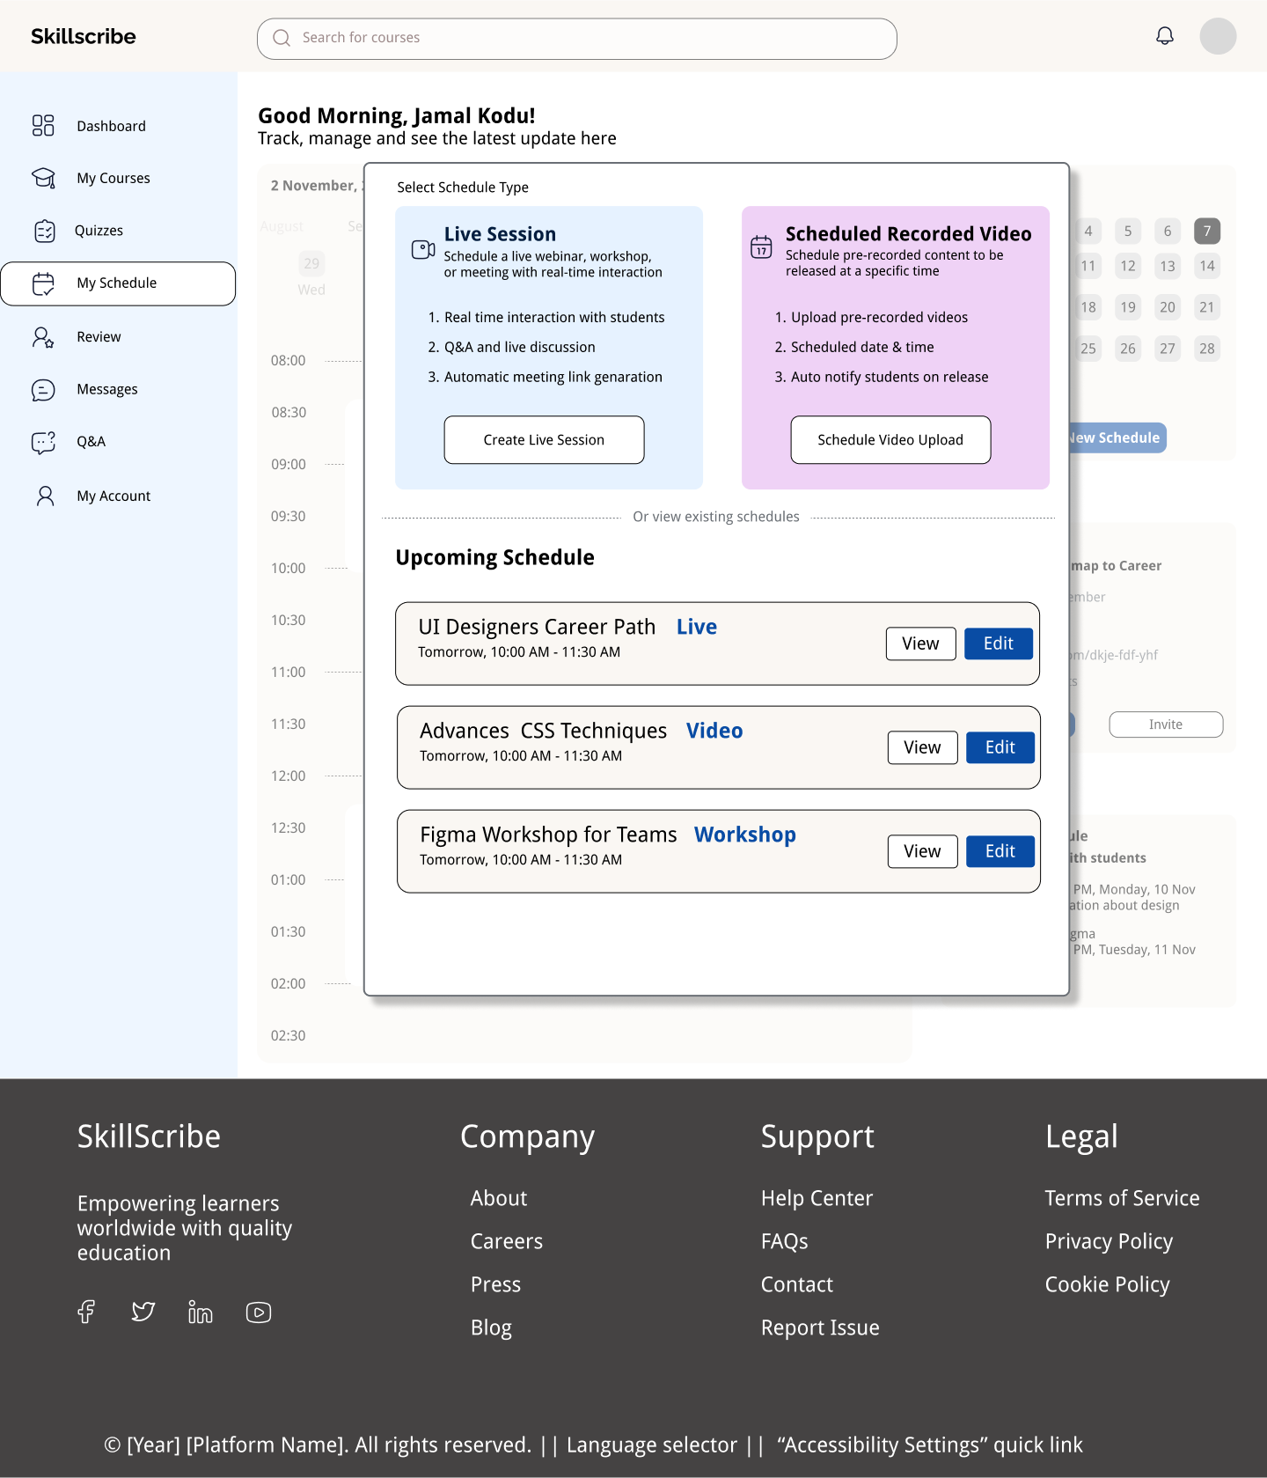
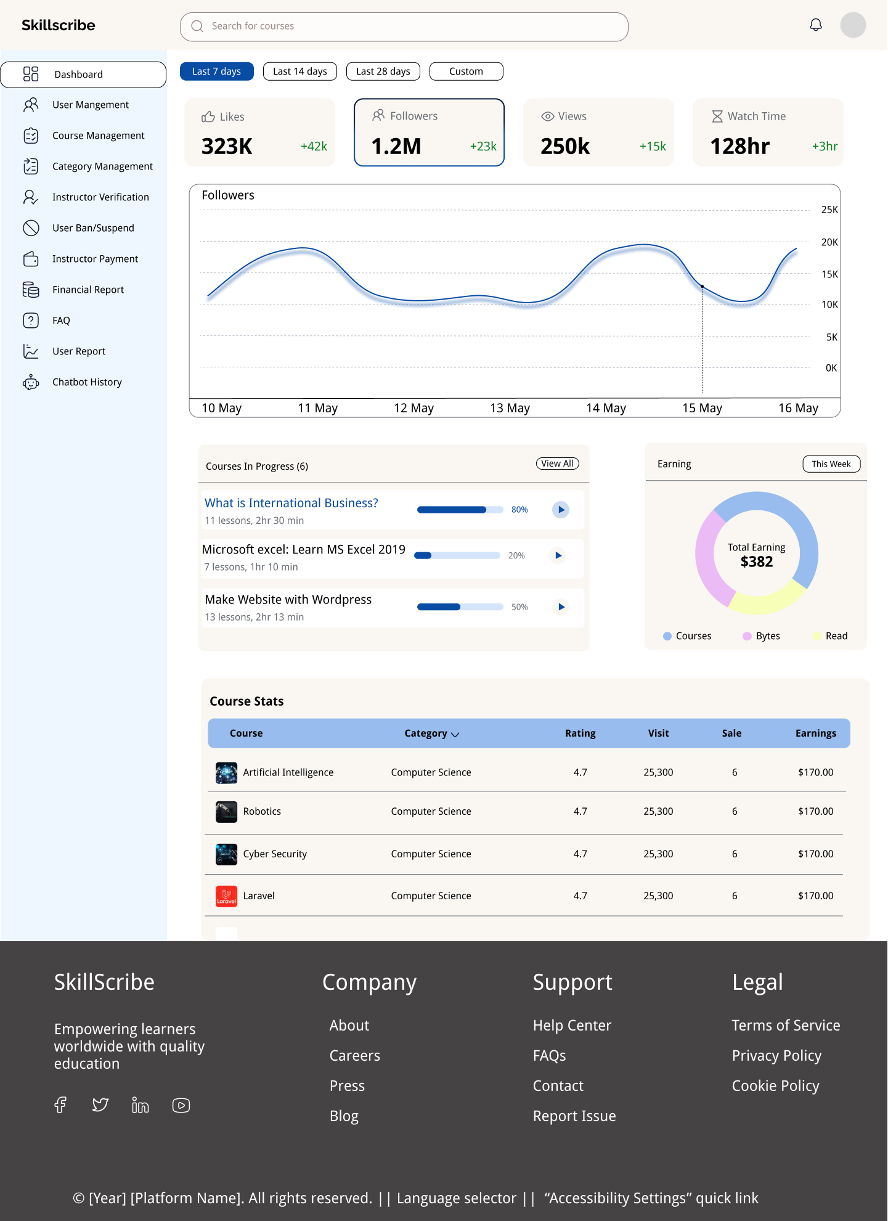
Project Involvement
Skillscribe - Instructor & Admin
Outcome
Designed course creation flow with module and video scheduling interfaces
Created instructor dashboard for tracking student enrollment and engagement
Designed admin dashboard for supervising users and verifying instructor and course approvals
Designed financial report and platform settings pages
Gained experience designing content
management and dual-role interfaces
Learned to design dual-role flows where
one user serves another

Slide 32
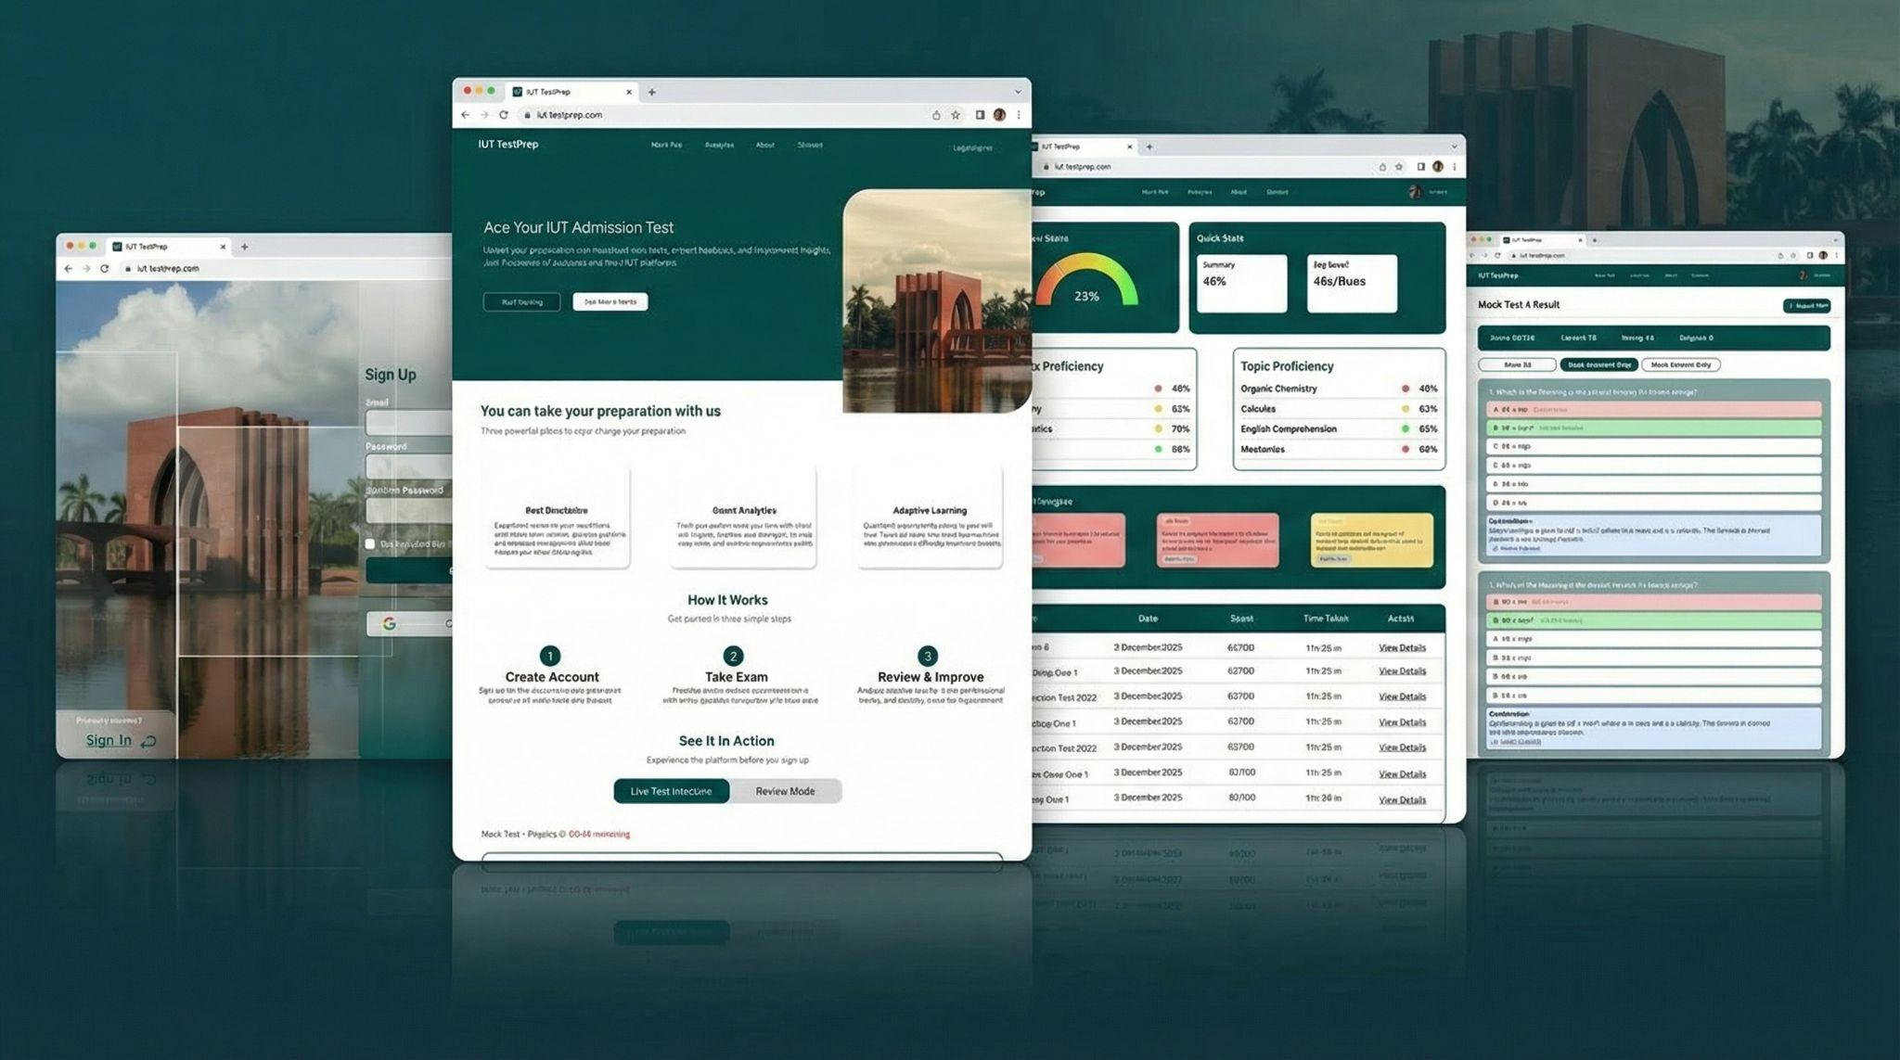
Project Involvement
2. IUT TestPrep
Outcome
Designed the complete user-facing section including landing page, dashboard, mock exam interface, and analytics screens
Led end-to-end UI/UX design based on user-centered design principles
Performed frontend testing and documented usability issues
Strengthened skills in designing high-pressure, task-focused interfaces
Improved ability to translate client feedback
into iterative design updates

Slide 33
Project Involvement
3. GPDI Platform
Outcome
Conducted comprehensive UI and frontend testing for the GPDI AI procurement intelligence platform
Systematically documented bugs, interface inconsistencies, and usability issues in Google Sheets
Validated design implementation against original Figma specifications.
Developed structured approach to quality
assurance and bug documentation
Gained understanding of how design translates
into production-ready frontend code

Slide 34


Tools and Technologies
Figma
Google Sheet
Google Chat

Slide 35





Soft Skills
Punctuality
Team Work
Adaptability
Collaboration
Critical Thinking

Slide 36
Saadman Sakib
210042165
October 12, 2025 - February 12, 2026
‹#›

Slide 37
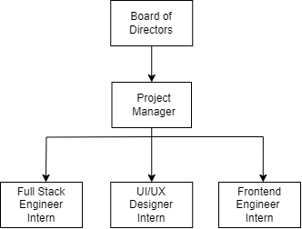
Team Overview
Simple, but specialized.
Received tasks directly from Project Manager
Used Google Chat for resource sharing, updates, and quick check-ins
Collaborated closely with designer to design-to-implementation alignment

Slide 38
Project Involvement
Skillscribe - Instructor & Admin
Implemented instructor-side interfaces including schedule management, quiz creator, dashboard analytics, messaging, profile, and review system
Developed authentication flow (Sign In / Sign Up) and static pages (About, Contact)
Built instructor dashboard for monitoring course activity and engagement
Implemented admin dashboard for user supervision and course approval overview

Slide 39
Company Focused Training Phase
1
2
3
OTT & Streaming Platforms
Subscription Model & Targeted Advertising System
Video Transcoding Pipeline

Slide 40
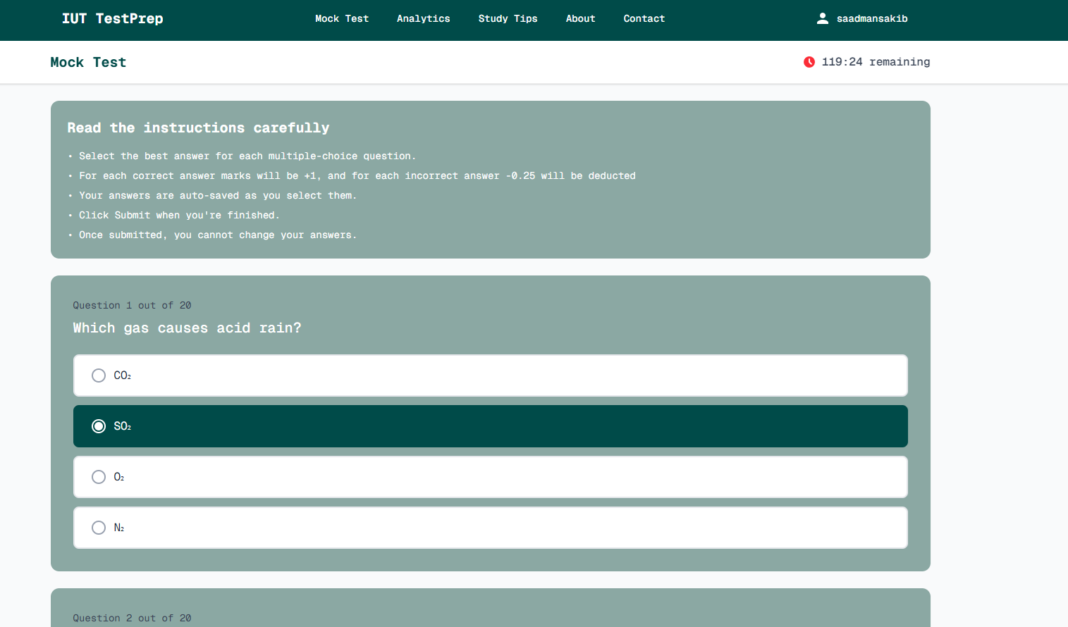
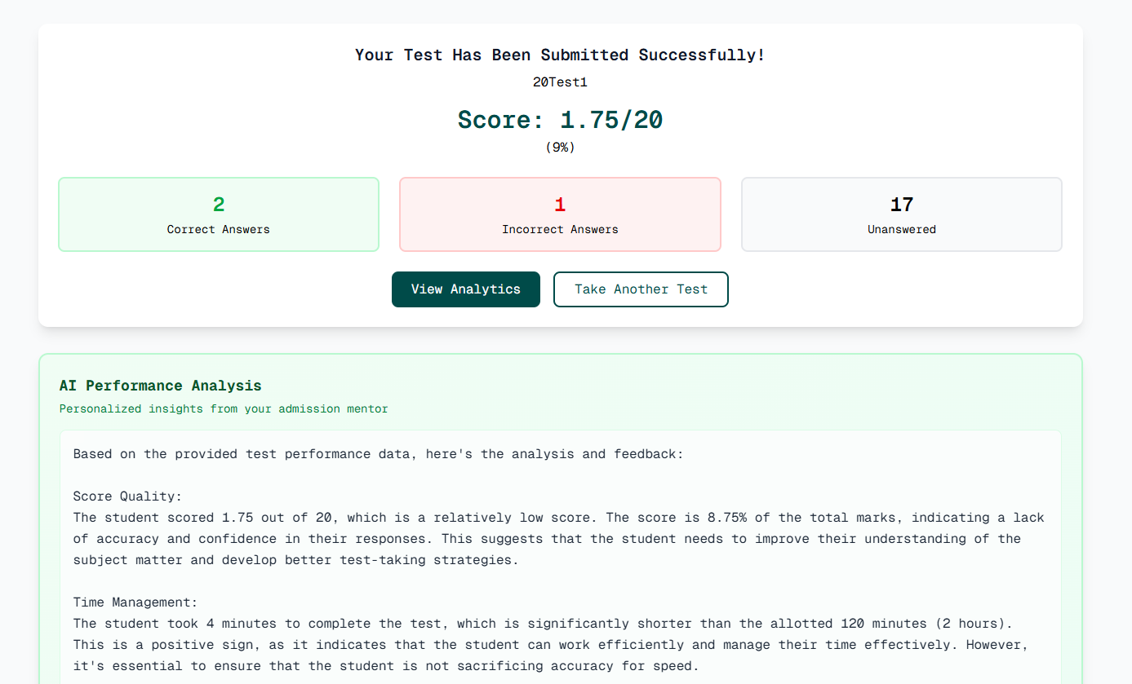
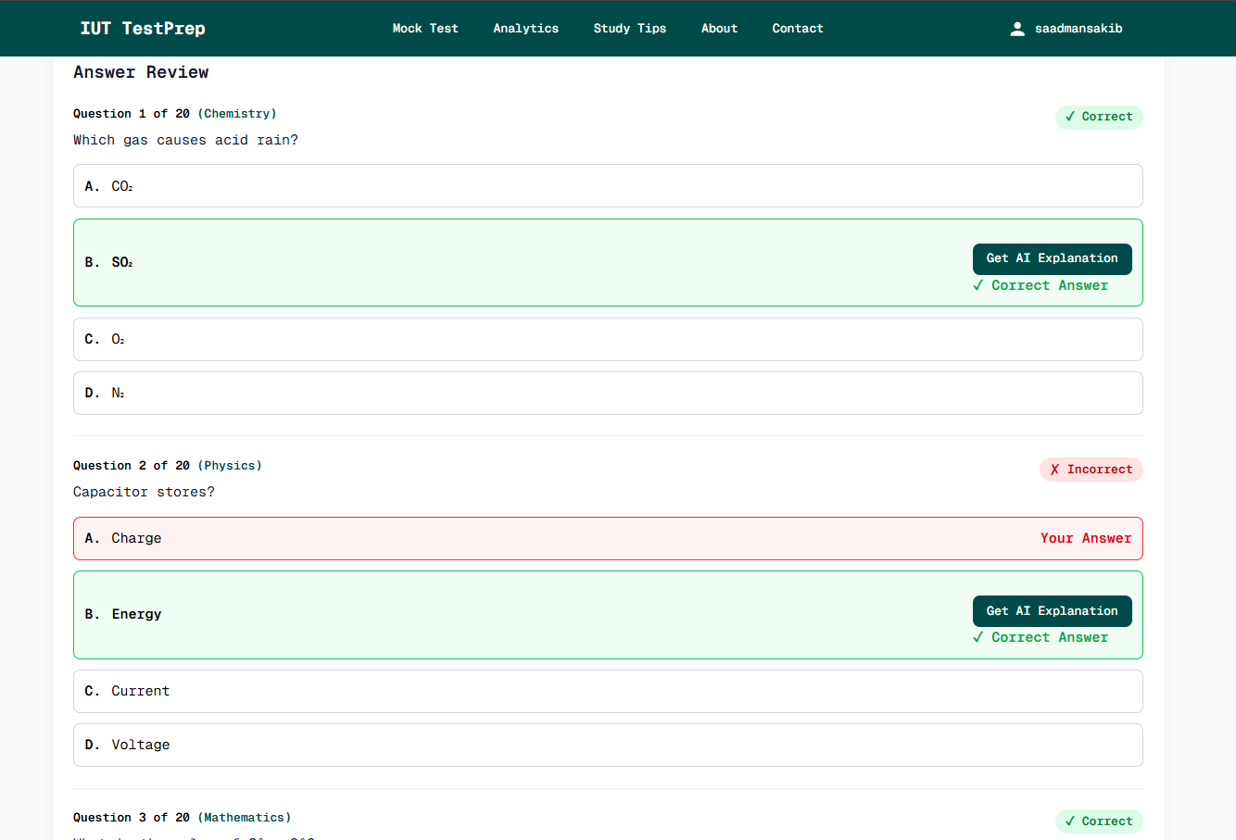
IUT Test Prep Server
Architected and implemented complete REST API layer for mock exam platform
Integrated AI services for explanation, test analysis, and coaching insights
Optimized performance using Redis caching and concurrency handling
Engineered exam integrity logic (session control, disconnect handling, anti-cheat rules)
‹#›

Slide 41
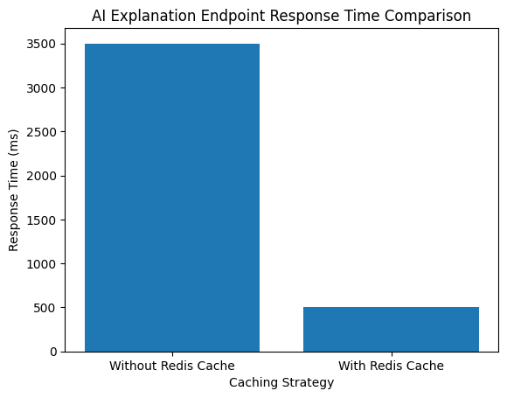
Performance Optimization : Redis Caching
Problem:
Repeated AI explanations caused 3–4s latency
Solution:
Implemented Redis caching layer for identical queries
Result:
- Response time reduced to - ~500ms
- Lower AI API calls
- Improved scalability under load

Slide 42
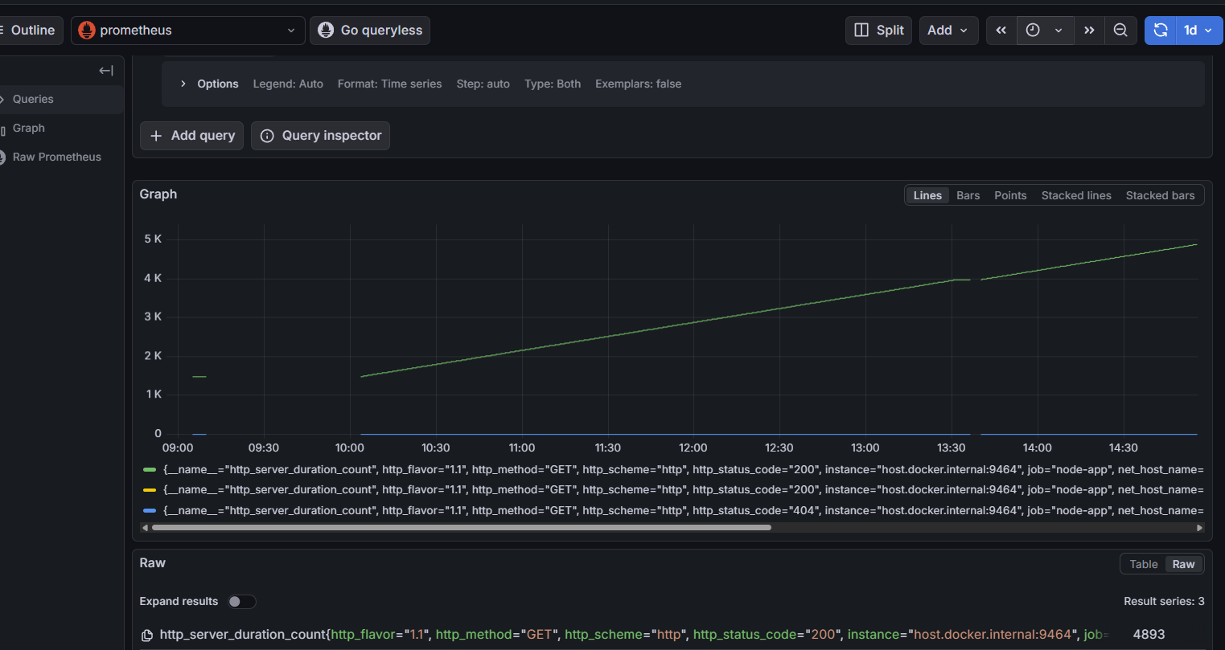
Monitoring & Observability
Dockerized backend services for isolated deployment
Integrated Prometheus with OpenTelemetry instrumentation
Visualized metrics using Grafana dashboards
Centralized logs with Loki for real-time debugging

Slide 43
Example Metrics
Server Response Duration
AI Request Frequency
Error Rate
Performance under load

Slide 44

Stress Testing & Load Simulation
Simulated 50 concurrent exam participants
Monitored response time and AI request spikes
Analyzed system behavior under peak load
Validated stability before deployment

Slide 45
Edge Case Handling & Exam Integrity
Handled mid-exam disconnection scenarios
Enforced single active exam session per question bank
Implemented anti-cheat session control logic
Designed fail-safe mechanisms for fairness

Slide 46
GPDI Platform
An AI Tender Incorporation (In House Product of TiCON)
Performed Automated Testing for authentication (50 times signin and signup) with Selenium and nopeCHA
Done Basic Smoke Testing for UI
‹#›

Slide 47
Tools and Frameworks
JavaScript
React
TypeScript
Next.js
Tailwind CSS
Google Chat
Github
Figma

Slide 48





Technologies
Docker
Prometheus
Grafana
Git
Loki

Slide 49




Soft Skills
Task Assessment
Deadline Discipline
Explaining Technical
Ideas Clearly
Team Communication
‹#›

Slide 50
Thanks!
‹#›

